Slide 1
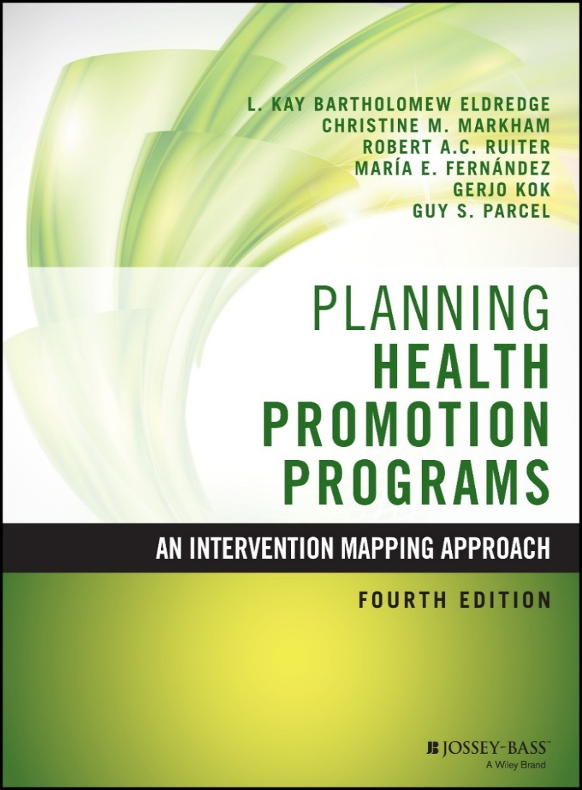
Intervention Mapping Step 6: Evaluation Plan with Patricia Dolan Mullen

Slide 2
Intervention Mapping Steps
Logic model of the problem
Program outcomes and objectives (logic model of change)
Program design
Program production
Program implementation plan
Evaluation plan

Slide 3
Evaluation Pyramid
Economic Evaluation
Eg. Cost Benefit Analysis
Effect Evaluation
Outcome/Impact
Process Evaluation
Fidelity, Dose, Completeness, Reach
Conceptualization of Program

Slide 4
Reasons for Evaluation
Formative evaluation of program & materials
Summative evaluation of efficacy and effectiveness
Program management and improvement
Generation of new knowledge
Different reasons for different stakeholders

Slide 5
Involving Evaluation Stakeholders
One important goal of evaluation is for someone to use the results
Identify stakeholders and involve them early
Plan structures for involving stakeholders in the ongoing evaluation process
Help stakeholders plan how to use evaluation data
Present evaluation results in multiple forms

Slide 6
Evaluation Stakeholders
Policymakers and decision-makers
Program sponsors
Evaluation sponsors
Target participants
Program managers
Program staff
Program competitors
Contextual stakeholders in program’s environment
Health education community
Evaluation & research community
Source: Rossi, P. H., Lipsey, M.W., & Freeman, H. E. (2004). Evaluation: A systematic approach (7th ed.,
pp. 48–49). Thousand Oaks, CA: Sage.

Slide 7
Step 6: Tasks
Write effect and process evaluation questions
Develop indicators and measures for assessment
Specify the evaluation design
Complete the evaluation plan

Slide 8
Task 1: Write Effect and Process Evaluation Questions
Effect evaluation – describes program’s efficacy or effectiveness
Process evaluation – describes program implementation
These questions will come from a review of the program logic models, goals, objectives, and matrices (i.e., from IM Steps 1-5)

Slide 9
Intervention Logic Model
INSERT FIGURE 9.1 HERE
Figure 9.1

Slide 10
Writing Effect Evaluation Questions
Does the program make a difference?
Health
Quality of life
Behaviors and environmental factors
Change objectives (determinants)
Consider time frame
Effect results may not be available within evaluation time frame

Slide 11
Writing Process Evaluation Questions
Context
Reach
Dose delivered
Dose received
Fidelity
Implementation
Recruitment
Linnan, L., & Steckler, A. (2002). Process evaluation for public health interventions and research: An overview. In A. Steckler & L. Linnan (Eds.), Process evaluation for public health interventions and research (pp. 1–23). San Francisco, CA: Jossey-Bass.

Slide 12
Task 2: Develop Indicators and Measures for Assessment
Define constructs
Look for measurable indicators for the constructs
Create or choose a measure
Consider validity – does the measure assess the intended construct?
Consider reliability – is the measure stable over time, across users?

Slide 13
Example Indicators and Measures
Health: Decrease in HIV, STI, and pregnancy
Indicators: Number of new HIV or STI cases, teenage pregnancies
Measures: Incidence statistics
Behavior: Condom use
(Among whom? How much? When?)
Indicators: Condom use at last intercourse
Measures: Self-report

Slide 14
Example Indicators and Measures
Determinants: Determinants variable
Indicators: Condom use self-efficacy
Measures: Condom use self-efficacy scale

Slide 15
Task 3: Specify the Evaluation Design
Key questions in effect evaluation
How do indicators of desired program effects compare with what happened before and after the program?
Can any changes observed be attributed to the intervention being evaluated?
Consider qualitative and quantitative methods

Slide 16
Traditional and Alternative Designs
Randomized controlled trial
Quasi-experimental design
Observational studies with propensity score matching
Time series designs
Pragmatic designs
Comparative effectiveness designs

Slide 17
Task 4: Complete the Evaluation Plan
Evaluation questions, design, indicators, measurement, timing
Statistical analyses and presentation of results
Description of how the evaluation will be carried out

Slide 18
Example
It’s Your Game…Keep It Real (IYG)
A sexual health education program for middle school students

Slide 19
Intervention Logic Model
INSERT FIGURE 9.3 HERE
Figure 9.3

Slide 20
Task 1: Write Effect and Process Evaluation Questions
Effect Evaluation Outcomes
Primary outcome
Did the intervention decrease the number of students who initiated sexual intercourse by 9th grade relative to students in the comparison condition?
Secondary outcomes
Did the intervention reduce:
Frequency of sex
Frequency of sex without a condom
Number of sexual partners
Dating violence victimization and perpetration
Did the intervention enhance:
Knowledge, skills, self-efficacy, outcome expectations, and normative beliefs related to sexual and dating behaviors

Slide 21
Task 1: Write Effect and Process Evaluation Questions
Reach: How many students received the program?
Dose: How many lessons did each student receive?
Fidelity: Was the program delivered as planned?
Cost: How much did the program cost to develop & implement?

Slide 22
Task 2: Develop Indicators and Measures for Assessment
Effect evaluation measures (Self-report)
Sexual behavior (lifetime & past 3 months)
Oral, vaginal, anal sex
Condom & contraceptive use
Testing for & experience of HIV, STI, pregnancy
Sample determinants’ scales
Knowledge (HIV, STI, condoms)
Normative beliefs (sex, condoms)
Self-efficacy (refusing sex, condoms)
Avoiding risky situations
Parent-child communication

Slide 23
Task 3: Specify the Evaluation Design
Randomized controlled trial (10 middle schools)
 | Baseline (7th Grade) | 7th Grade Lessons | 5-Month Post-Test | 8th Grade Lessons | 12-Month Post-Test | 24-Month Post-Test (9th Grade)
Intervention (5 schools) | O | X | O | X | O | O
Control (5 schools) | O |  | O |  | O | O

Slide 24
Task 4: Complete the Evaluation Plan
INSERT FIRST PAGE OF TABLE 9.8HERE
Table 9.8

Slide 25
Sexual Behavioral Results: 9th Grade
Outcome | N | ARRª | 95% CI
Initiated oral sex | 831 | 1.76** | (1.21, 2.56)
Initiated vaginal sex | 804 | 1.26 | (0.98, 1.61)
Initiated anal sex | 835 | 2.67** | (1.45, 4.94)
ª ARR – adjusted relative risk ratio (all models adjusted for age, gender, and race/ethnicity) denotes increased risk of initiating sex among comparison group students compared to students who received It’s Your Game. * p ≤ 0.05, ** p ≤ 0.01
Tortolero, S. R., Markham, C.M., Peskin, M. F., Shegog, R., Addy, R. C., Escobar- Chaves, S. L., & Baumler, E. R. (2010). It’s Your Game . . .Keep It Real: Delaying sexual behavior with an effective middle school program. Journal of Adolescent Health, 46(2), 169–179.

Slide 26
Effect on Determinants: 8th Grade
Total Sample | 8th Grade
Outcome (Range) | n | Difference in Adjusted Mean |  | Intervention |  | Control
 |  |  |  | Mean | SD | Mean | SD
Sexual beliefs (1-4) | 962 | 0.04 |  | 2.87 | 0.58 | 2.86 | 0.67
Abstinence beliefs (1-4) | 956 | 0.16 | ** | 2.75 | 0.69 | 2.61 | 0.75
Normative beliefs about sex (1-4) | 968 | 0.18 | ** | 2.46 | 0.71 | 2.33 | 0.69
Refusal self-efficacy (1-4) | 958 | 0.09 | * | 3.07 | 0.86 | 2.96 | 0.86
Condom knowledge (0-3) | 979 | 0.51 | ** | 2.56 | 0.73 | 2.06 | 1.01
Condom normative beliefs (1-4) | 959 | 0.07 |  | 3.37 | 0.67 | 3.31 | 0.66
Condom self-efficacy (1-3) | 960 | 0.11 | ** | 2.51 | 0.39 | 2.38 | 0.43
Risky situations (0-3) | 960 | -0.09 | * | 0.77 | 0.66 | 0.85 | 0.70
HIV/STI knowledge (0-1) | 948 | 0.05 | ** | 0.83 | 0.24 | 0.78 | 0.25
Intent: oral in next year (1-5) | 970 | -0.25 | ** | 1.98 | 1.27 | 2.17 | 1.25
Intent: vaginal in next year (1-5) | 967 | -0.04 |  | 2.32 | 1.35 | 2.35 | 1.31
Intent: abstinent thru HS (1-5) | 967 | 0.32 | ** | 3.13 | 1.43 | 2.86 | 1.40
Parent-child communication (0-8) | 916 | 0.35 | * | 4.70 | 2.83 | 4.36 | 2.74
All models adjusted for age, gender, race/ethnicity and baseline score
* p ≤ 0.05, ** p ≤ 0.01

Slide 27
Effect on Determinants: 9th Grade
Positive sustained results into 9th Grade
Beliefs about abstinence
Risky situations
HIV/STI knowledge
Condom knowledge
Factors that became statistically significant
Normative beliefs about sex
Perceived condom norms
Notes:
It’s Your game Preventive

Slide 28
Dissemination of It’s Your Game
It’s Your Game . . . Keep It Real is nationally recognized as an effective sexual health education program (USDHHS, 2015)
Adopted by school districts across the U.S., reaching more than 33,000 middle school students
Much of the program’s success may be attributed to the use of Intervention Mapping to systematically guide program development and dissemination
U.S. Department of Health and Human Services Office of Adolescent Health. (2015).
Teen pregnancy prevention resource center: Evidence-based programs. Retrieved from http://www.hhs.gov/ash/oah/oah-initiatives/teen_pregnancy/db/index.html

Slide 29
Summary
IM Step 6 comprises 4 key tasks:
Write effect and process evaluation questions
Develop indicators and measures for assessment
Specify the evaluation design
Complete the evaluation plan

Slide 30
Questions?

